Slide 1

Bright Coffee Shop Sales Data Analysis For Period January 2023-June2023
Store Locations: Astoria, Hell's Kitchen and Lower Manhattan

Slide 2
Sales/Revenue Analysis For Bright Coffee Shop for Period 1 Jan 2023-30 June 2023
This presentation provides an in-depth review of sales performance across the Bright coffee shops for the period 1 Jan 2023-30 June 2023. Bright Coffee Shop has generated Total Revenue of R698 812.33 .
Location contribution to total Revenue:
Astoria R232 243.91
Hell's Kitchen R236 511.17
Lower Manhattan R230 057.25

Slide 3
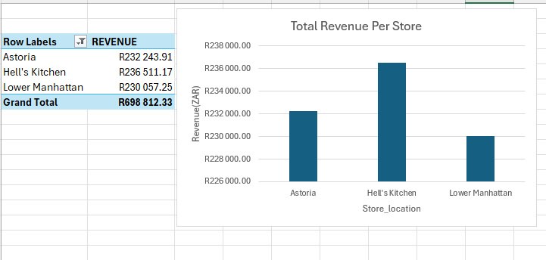
Total Revenue Per Location[Jan-Jun]
Total Revenue generated by different Locations in the past 6 months. Hell’s Kitchen has higher revenue followed by Astoria and Lower Manhattan.

Slide 4
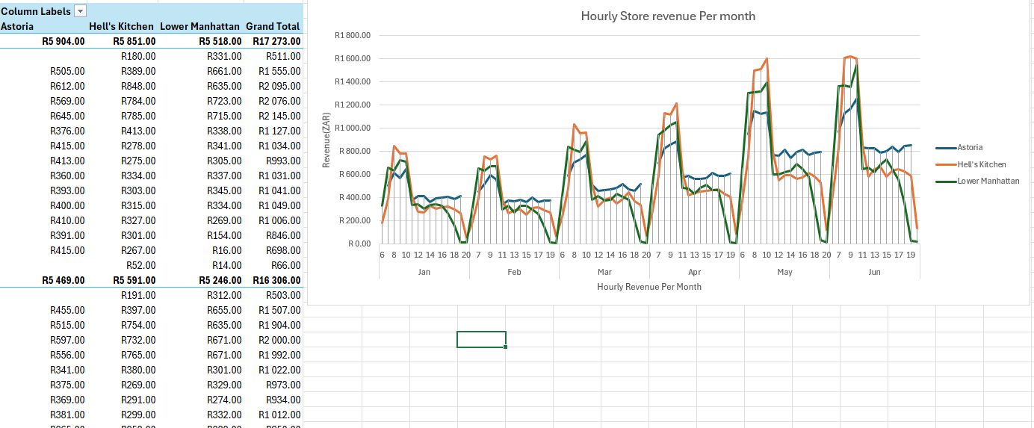
Hourly Revenue
This is an hourly revenue per location. Based on the data, the revenue is higher from morning until late afternoon in all three locations.

Slide 5
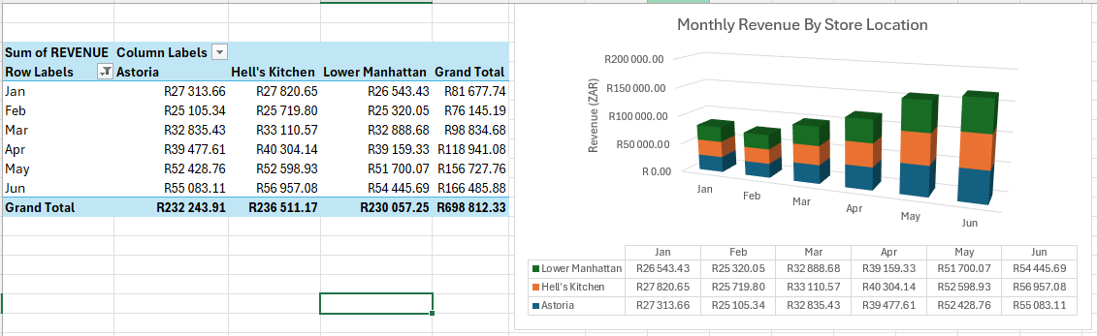
Working together in real time
Total Revenue generated by different Locations Month on Month. The month-on-month revenue for all locations ranges between R26.000-R56000.The revenue increases gradually from month one until month six.
2
When other people are in the presentation, a marker shows who is on which slide…
3
…and the part of the slide they're editing.

Slide 6
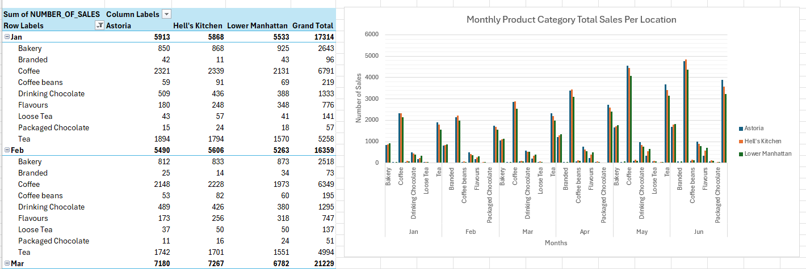
Product_Category_Sales
Products category sales in different locations month-on-month. Coffee and tea are the most sold products in all locations.

Slide 7
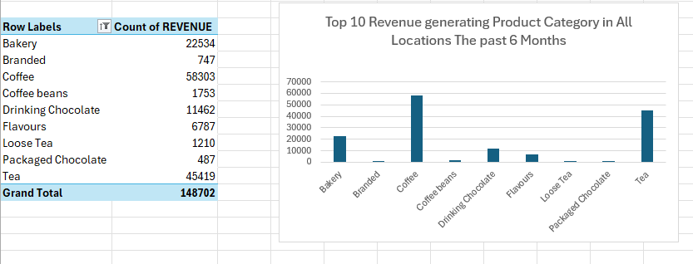
Top 10 Revenue Generating Products
Top 10 revenue generating Products category sales in different locations month-on-month. Coffee and tea are the most sold products in all locations that contribute high revenue.

Slide 8
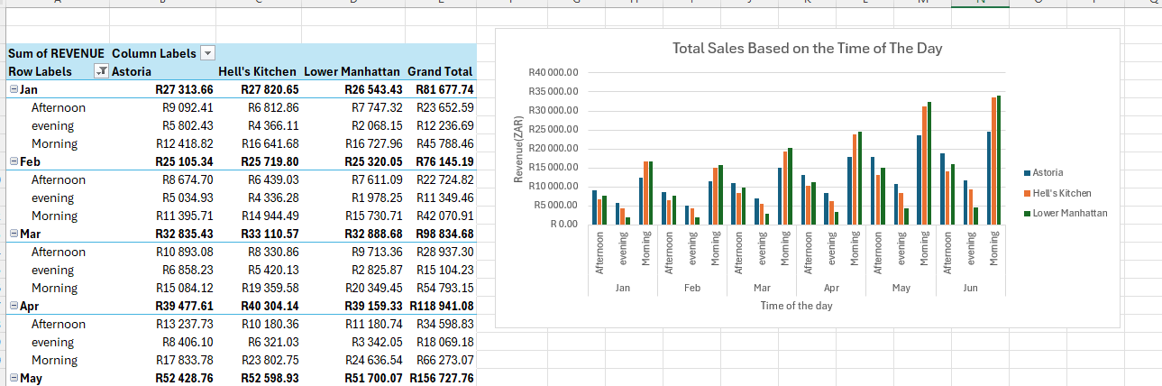
Revenue Based on Time of the day
The revenue is being provided based on the time of the day. Based on the data, more revenue/sales is generated in the morning.

Slide 9
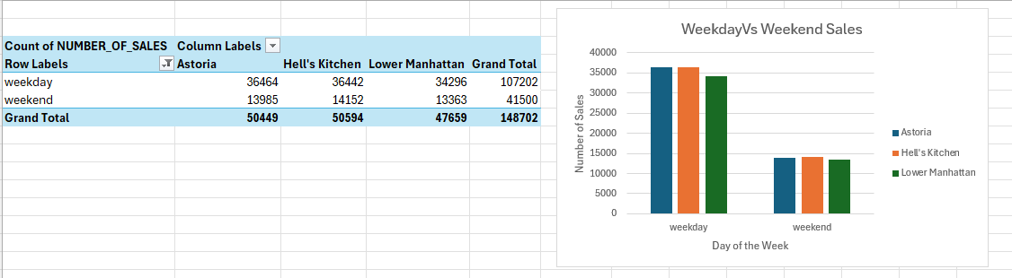
Weekday Vs Weekends Sales Split
More sales takes place more during the week in comparison to weekends.

Slide 10
Executive Summary
All three coffee shops has almost similar revenue/sales.
The shops are busier in the mornings.
Coffee and Tea are the most sold products.
The Bright Coffee Shops operate for 7 days from 06:00 until 21:00
The overall generated revenue is R698 812.33 .
Location contribution to total Revenue:
Astoria R232 243.91
Hell's Kitchen R236 511.17
Lower Manhattan R230 057.25

Slide 11
Recommendations
Marketing campaigns during slow time slots
Stock more of the best-selling items
Promote underperforming products

Slide 12
Thank you

